Slide 1
License Plate Detection
Names & ID’s:
1-Omar Khaled – ID:94105
2-Mostafa Tarek – ID:94071
3-Mohamed Ezz – ID:94303
4-Mohamed Omar – ID:94114
5-Basel Ahmed – ID:98052

Slide 2
Agenda
01
04
Problem Statement
Our Workflow
02
05
Some Trials
Further Improvements
03
Why YOLO?

Slide 3
Problem Statement
Nowadays, organizations try to increase safety and security among themselves, so, it is important for them to notice who entered the organization and who left.
So, many organizations have their security systems which includes cars license plate detection Sydtem

Slide 4
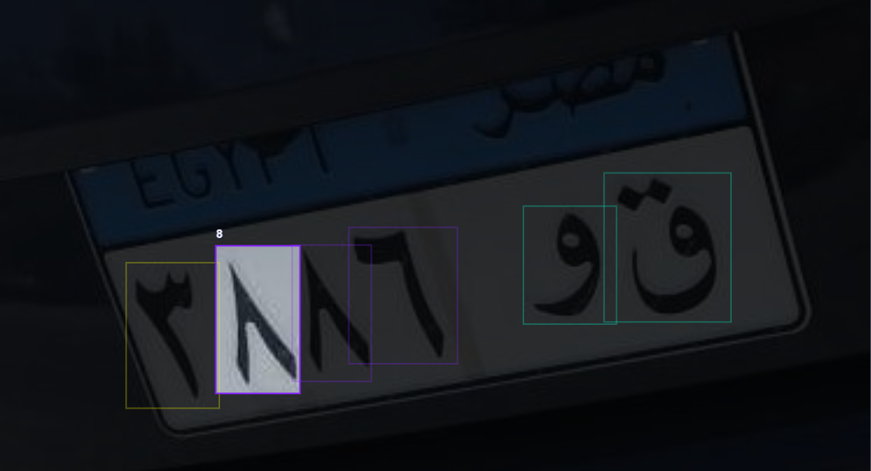
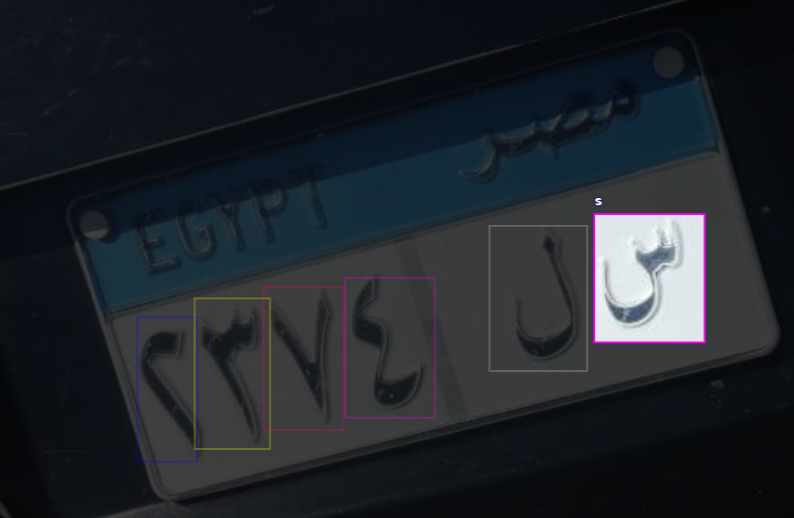
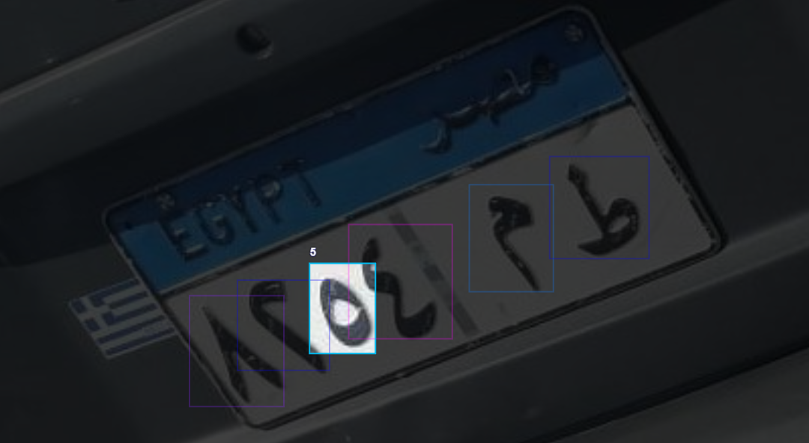
Data Collection and Annotation

Slide 5
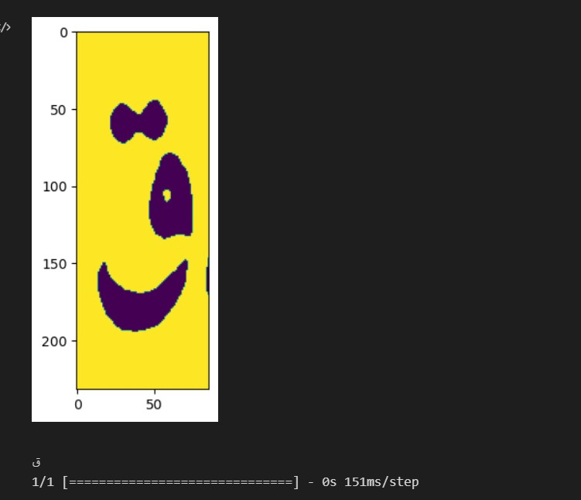
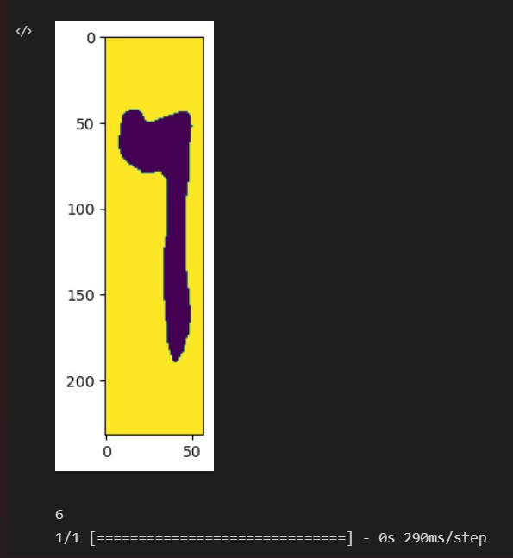
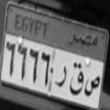
Some Trials : Trial 1

Slide 6
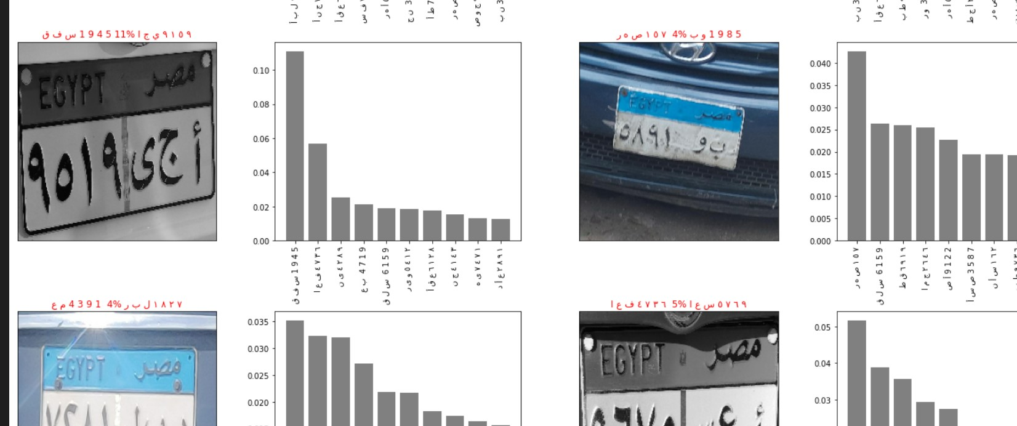
Trial 2

Slide 7
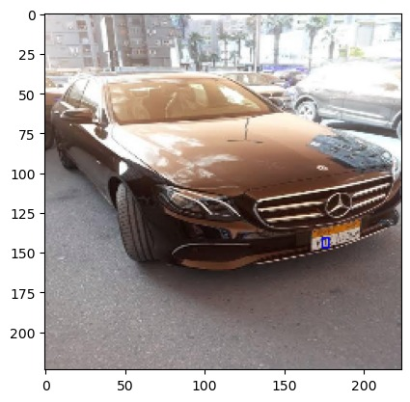
Trial 3
1- Using VGG
2- Accuracy 60%
3- Time consuming and has problem to detect more than item in image with xml file

Slide 8
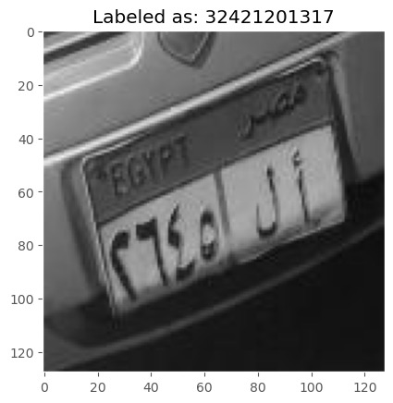
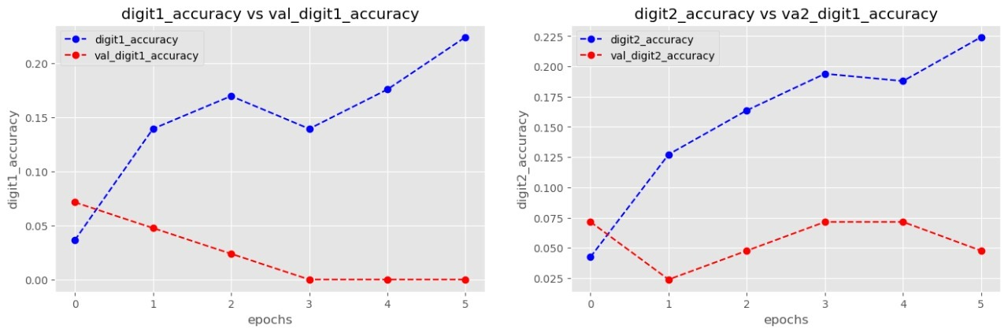
Trial 4
1-Convert all labels to label encoding 2- convert it to set of sequences and attach image to its labels to let shape(27,128,128,3)

Slide 9
Why YOLO?
1- YOLO is one stage Detector
2- YOLO is a much faster algorithm than its counterparts.
3- It’s high accuracy in predictions and a better Intersection over Union in bounding boxes

Slide 10
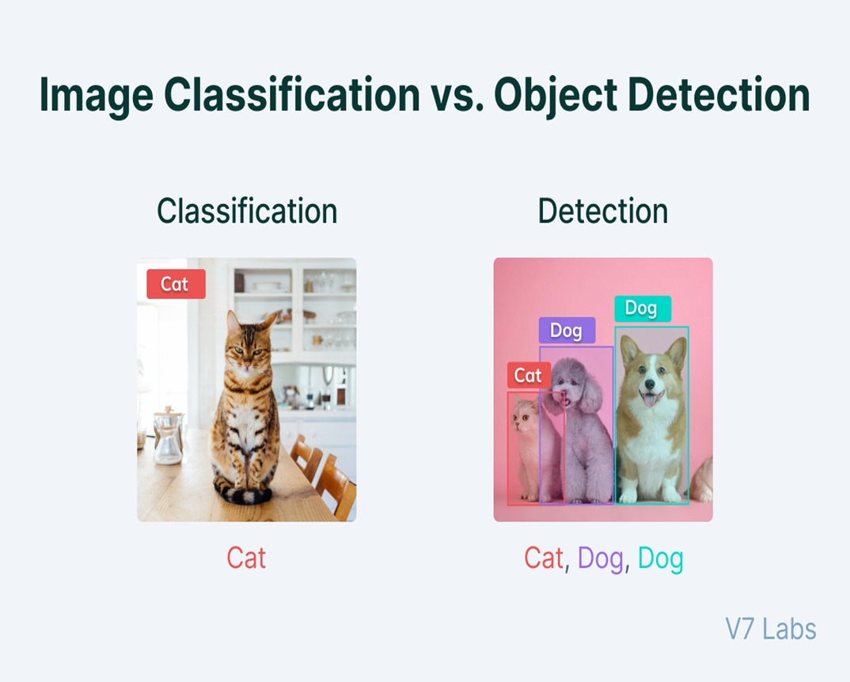
Why Object Detection?

Slide 11
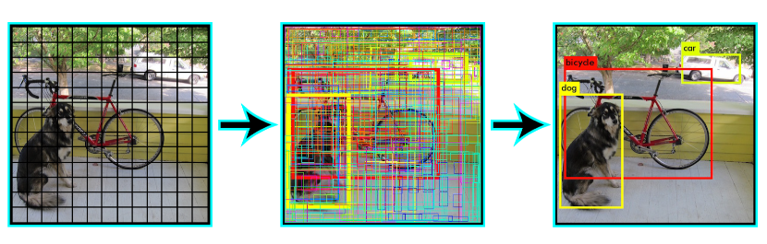
How YOLO Works?
The YOLO algorithm works by dividing the image into N grids, each having an equal dimensional region of SxS.

Slide 12
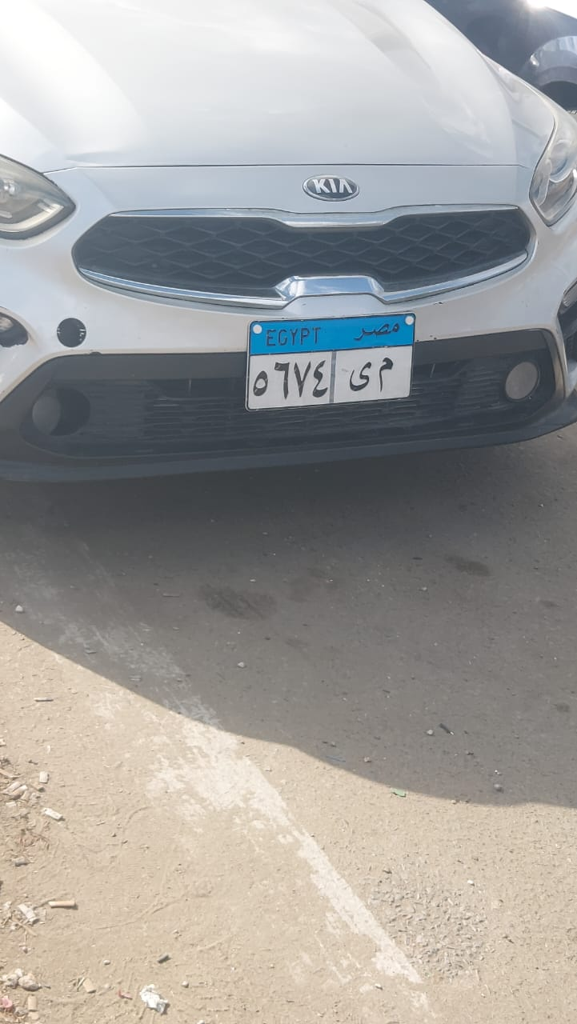
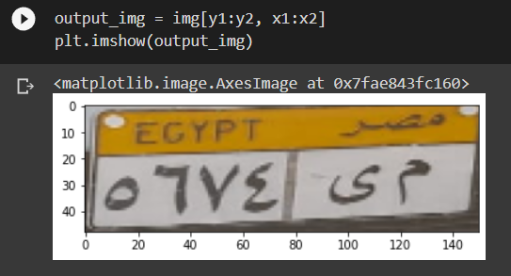

Our Workflow
Image Capturing
Plate Recognition
Recognizing Plate Number

Slide 13
Different Models mAP
100 epoch
150 epoch
230 epoch

Slide 14
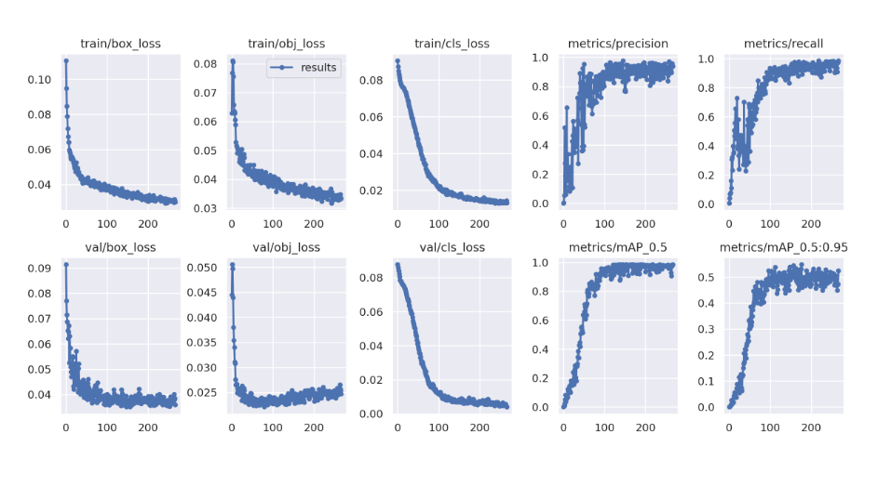
YOLOV7 Model Graphs

Slide 15
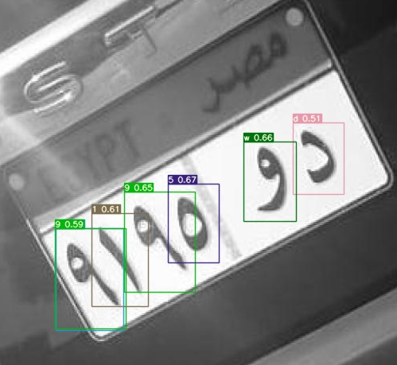
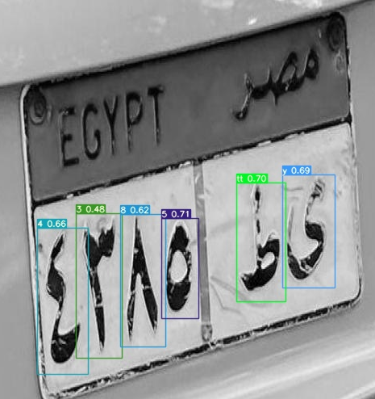
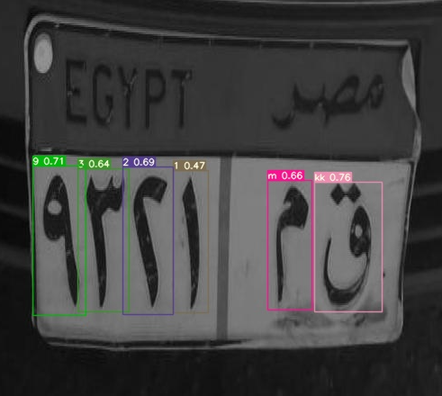
Output Samples

Slide 16
Further Improvements
Implementing an Easy UI/UX.
Increasing Data Given to the 2 YOLO Models.
Increasing Models Performance
Implementing Backend to the Application

